Slide 1

WORLD HERITAGE EMBLEM
& COMBINED LOGOS

Slide 2

Why use the World Heritage Emblem?
The proper use of a shared and unique emblem contributes to:
  Immediate identification
  Accurate information
  Better orientation
  Belonging to a global network
  Branding reinforcement

Slide 3





Which emblems and logos ?
There are different logos and emblems for different users and different uses

Slide 4
I - The UNESCO logo
Official graphic charter
Temple
Acronym

Slide 5
I - The UNESCO logo
  For uses dealing with general topics
  Ruled by the Directives concerning the use of the name, acronym, logo and Internet domain names of UNESCO
  Managed by the Division for Communications and Public Engagement (CPE)
  All projects must be submitted for approval before production
  Contact: logo@unesco.org

Slide 6

II – The World Heritage Emblem
  Adopted in 1978
  Symbol of the interaction between Human Being and Nature
  Defined in Chapiter VIII of the Operational Guidelines for the Implementation of the World Heritage Convention

Slide 7
II - The World Heritage Emblem
Can be used by the competent authorities for:
  Smaller-scale communication materials
  (e.g.: social media, free stickers, flyers, pins, usb key, etc.)
  Road signs
  (e.g.: signs indicating ways to reach the site)
  Signs within the site
  (e.g.: information stands, pathways, walkways, building signs, etc.)
  Communication materials for commercial use*
  (any products or souvenirs for sale – see slide 9)

Slide 8
II - The World Heritage Emblem
Excerpt from the Operational guidelines Chap. VIII
Use -
VIII.E, 275, a)
« The Emblem should be utilized for all projects substantially associated with the work of the Convention, […] , in order to promote the Convention. »
VIII.E, 275, b)
« […] The main criterion for approval should be the educational, scientific, cultural, or artistic value of the proposed product related to World Heritage principles and values […] . »
and
«. Approval should not routinely be granted to place the Emblem on products that have no, or extremely little, educational value, such as cups, T-shirts, pins, and other tourist souvenirs…»
VIII.E, 275, d)
«.Except when authorized in accordance with these principles it is not legitimate for commercial entities to use the Emblem directly on their own material to show their support for World Heritage […] »

Slide 9
II - The World Heritage Emblem
*Commercial use - Excerpt from the Operational guidelines Chap. VIII
VIII.E, 275, b)
«A decision to approve use of the Emblem should be linked strongly to the quality and content of the product […] »
VIII.E, 275, h)
«When commercial benefits are anticipated, the Secretariat should ensure that the World Heritage Fund receives a fair share of the revenues and conclude a contract or other agreement […] »
and
«National authorities are also called upon to ensure that their properties or the World Heritage Fund receive a fair share of the revenues […] ».

Slide 10
III - The Combined Logos
UNESCO developed several logos combining :
The UNESCO temple on the left
The secondary logo (Conventions, programmes, etc.) on the right
The acronym of the Organization underneath
And various mentions
For World Heritage, combined logos include:

Slide 11

III.1 - The combined logo for National Commissions and Agencies
The UNESCO temple + the World Heritage Emblem
+
The acronym « UNESCO »
+
« World Heritage in [country’s name] »
This combined logo :
Covers all World Heritage sites in a country
For use by National Commissions and designated Agencies
For national or worldwide projects

Slide 12
III.2 – The combined logo for World Heritage sites
Each World Heritage site has a generic logo:
Unique and common to all World Heritage sites
Exclusive use for national authorities and official management entities of the site
Use for free information and communication materials (brochures, flyers, posters, maps, stickers, letterheads, road signs, site entrances and exits, etc.)
Not for commercial products
No modifications of any kind (proportions, colour, font,
content insertion, partial use, etc.)
Validation before printing or production of each mock-up by UNESCO
(contact: wh-info@unesco.org )

Slide 13
III.3 – The combined logo for UNESCO Secretariat
Other combined logo – The logo of the World Heritage Convention
UNESCO Temple
+ World Heritage Emblem
+ «World Heritage Convention»
for the exclusive use of the Secretariat of the Convention

Slide 14
III – The World Heritage combined logos
These logos are created and provided:
By UNESCO services only
Upon official request sent by email to UNESCO
(wh-info@unesco.org)
In English and French + potentially the national language of the country, upon request
In vectorized .pdf format (allowing graphic work in very high resolution whatever the medium’s size)

Slide 15
IV – Rules governing the use of the Emblem and the combined logos
Key dates:
  2007: Ruled by the Operational Guidelines + the UNESCO Directives
  2010-2014: Working Group for a revision of the Operational Guidelines
  2015: revised Operational Guidelines + Annex 14 adopted at the 39th session of the World Heritage Committee
  2021: New Graphic Charter of the UNESCO logo
  2023: Revision of the Operational Guidelines + Annex 14 at the 45th extended session of the World Heritage Committee

Slide 16
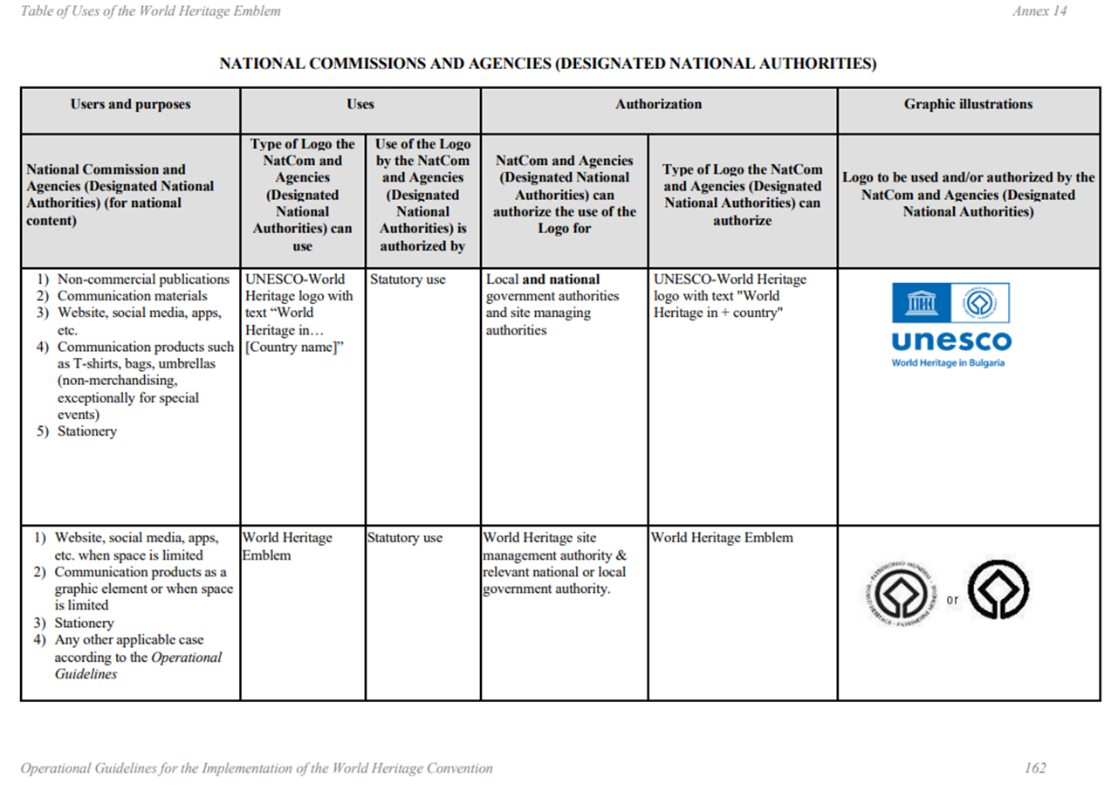
IV.1 - Excerpts from the Annex 14 to the Operational Guidelines

Slide 17
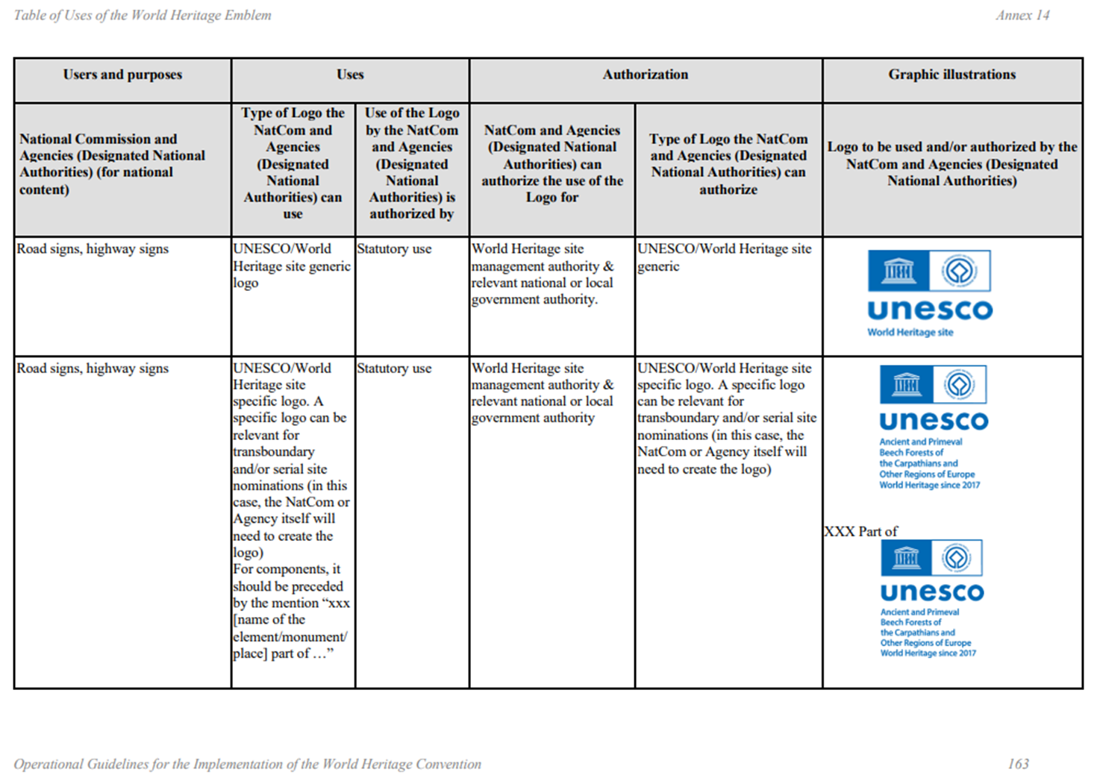
IV.1 - Excerpts from the Annex 14 to the Operational Guidelines

Slide 18
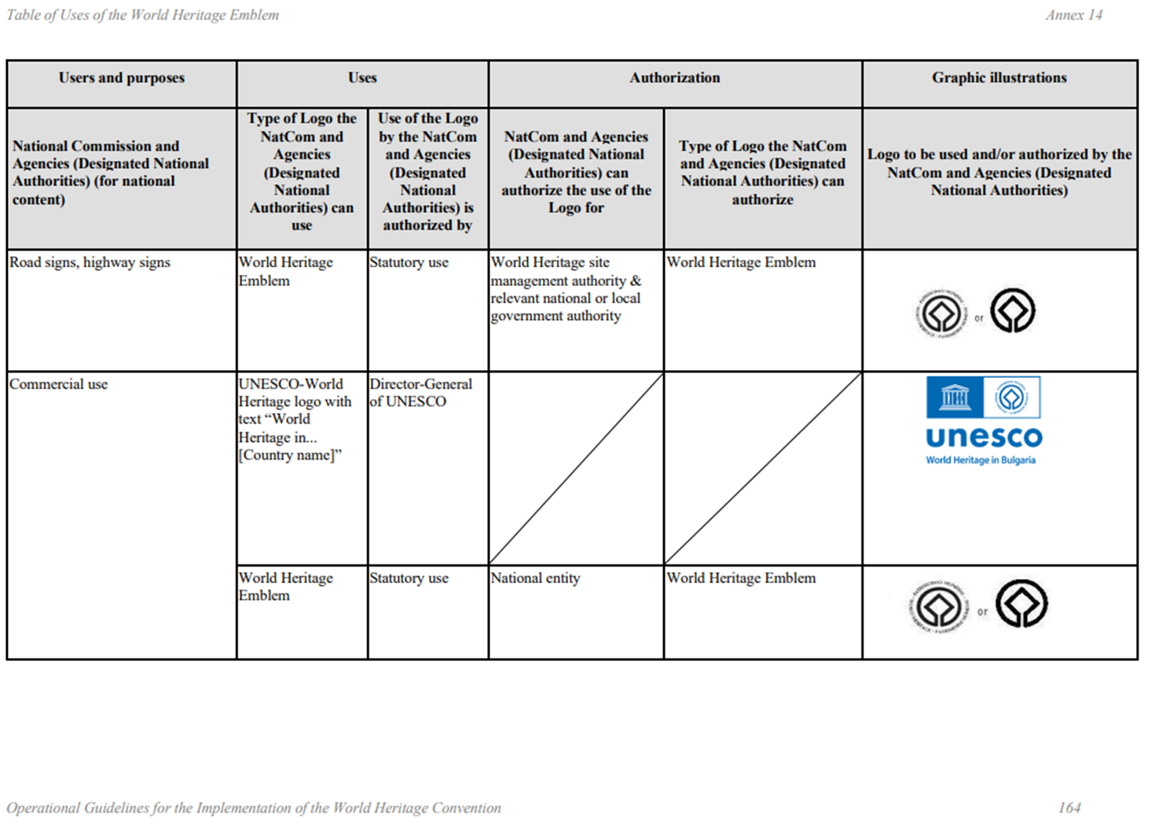
IV.1 - Excerpts from the Annex 14 to the Operational Guidelines

Slide 19
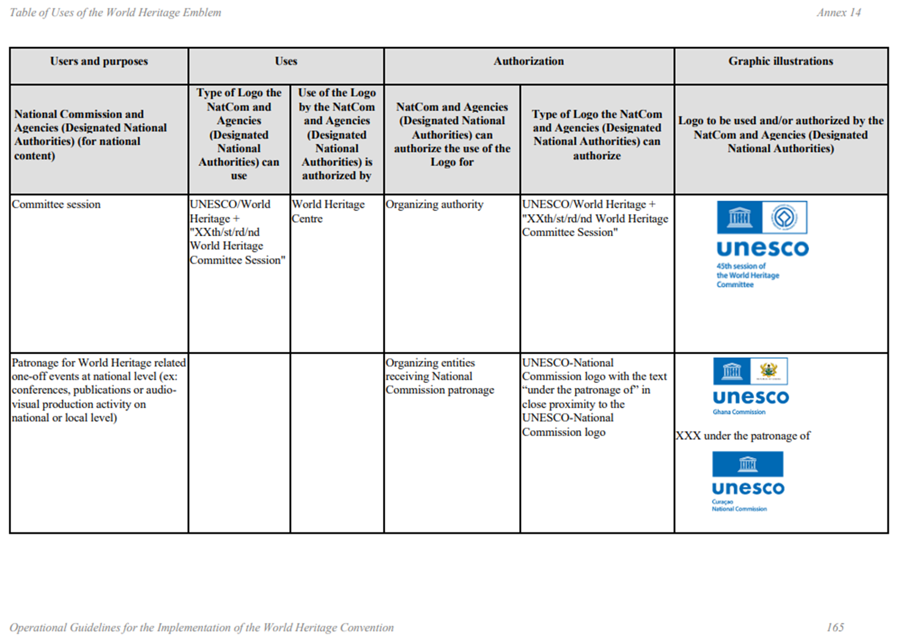
IV.1 - Excerpts from the Annex 14 to the Operational Guidelines

Slide 20
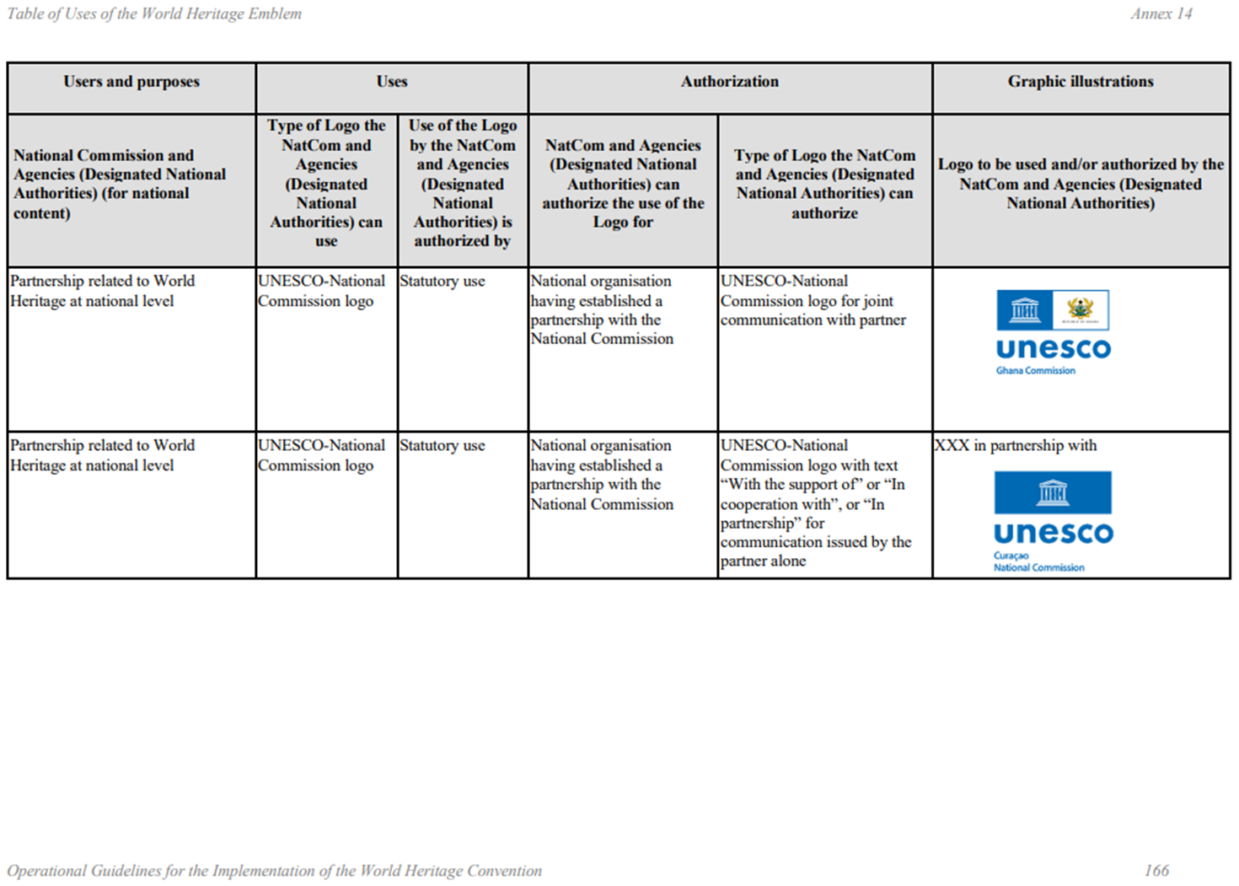
IV.1 - Excerpts from the Annex 14 to the Operational Guidelines

Slide 21
IV.2 - Example of use
Commemorative plaque of the site:
  The plaque should be so placed that it can easily be seen by visitors, without disfiguring the property;
  The choice of materials and format, left to the discretion of the site, should respect the spirit of the place;
  The World Heritage emblem or the site-generic logo should appear on the plaque;
  The text should mention the property's Outstanding Universal Value (OUV);
  The text should make reference to the World Heritage Convention, to the World Heritage List, and to the international recognition conferred by inscription on this List.
Example of text proposed by the Committee (OG, Chap. VIII, art. 270-271) :
"(Name of property) has been inscribed upon the World Heritage List of the Convention concerning the Protection of the World Cultural and Natural Heritage. Inscription on this List confirms the Outstanding Universal Value of a cultural or natural property which deserves protection for the benefit of all humanity."

Slide 22
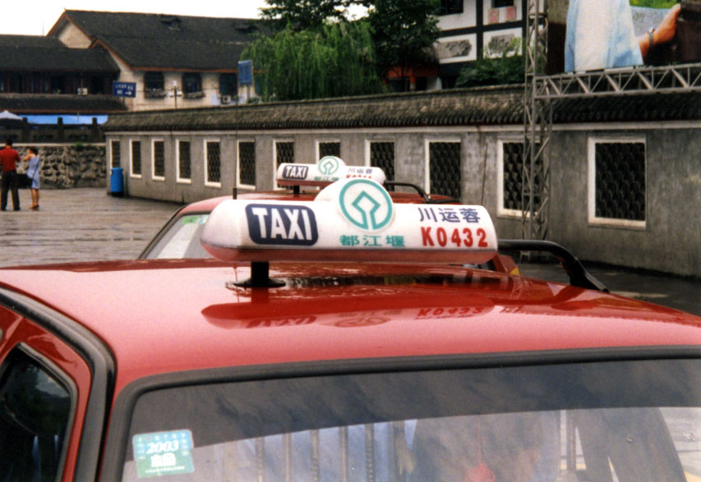
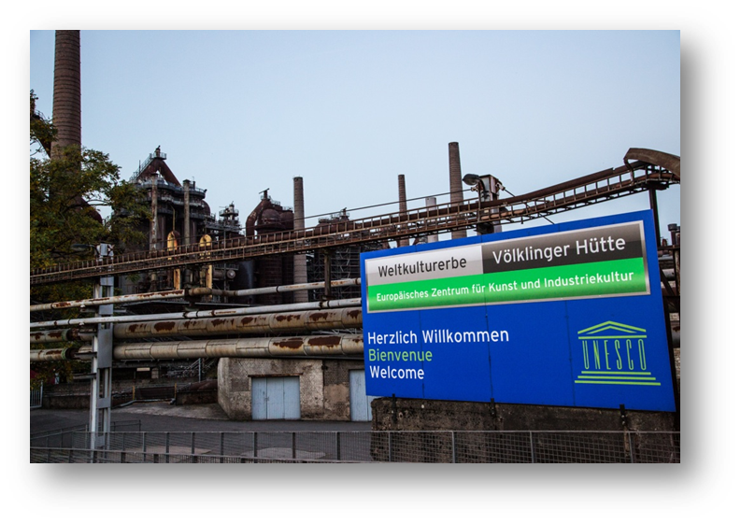
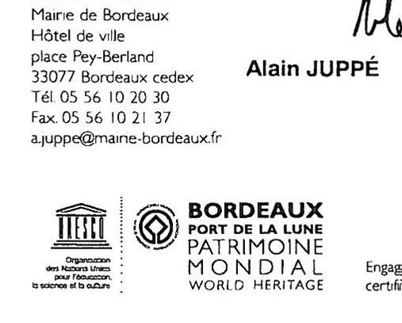
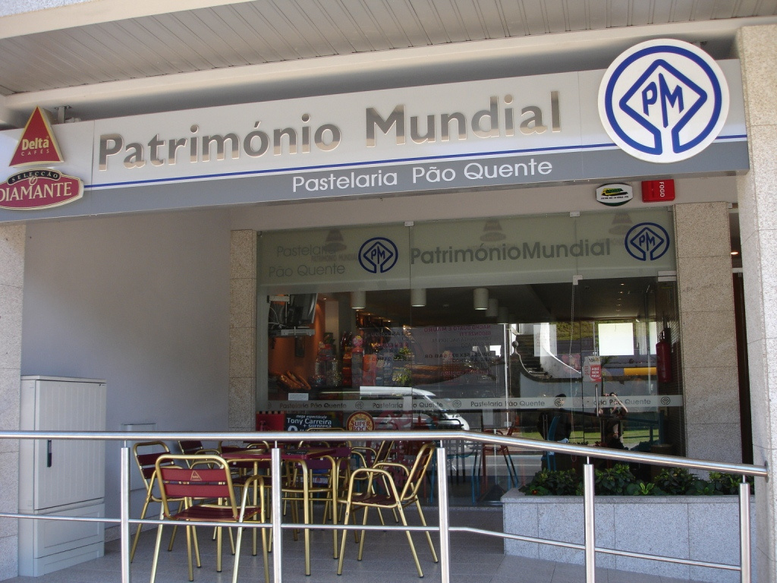
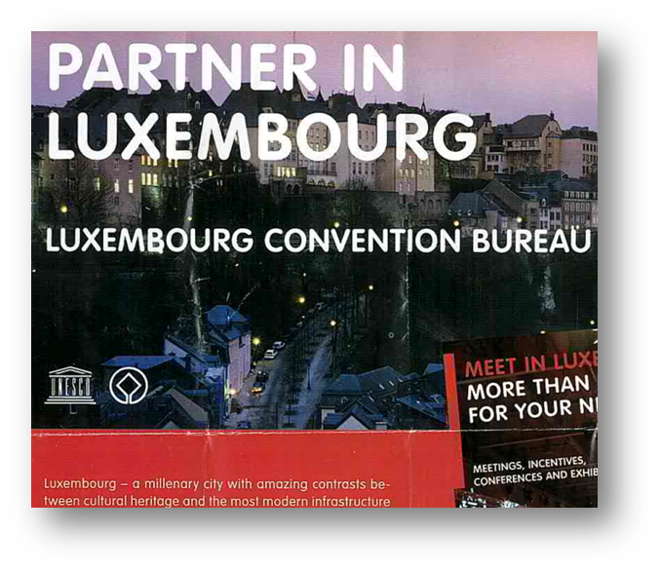

IV.3 - Examples of misuses
Examples of unofficial or unauthorized logos
Consequences:
Confusion for the public
No benefit for the site, the country or UNESCO
No quality control

Slide 23
Conclusion
Use logos to promote sites and raise awareness of the World Heritage Convention
Help us identifying misuses
Contact us for information, assistance, or to submit a request:
wh-info@unesco.org

Slide 24

Thank you
Culture Sector
Communication, Cities, Events Unit
(CLT/CCE)

