Slide 1
Inception meeting for the Second Cycle of Periodic Reporting, Reflection Period
Current indicators in the Periodic Reporting Questionnaires
Ole Søe Eriksen
Independent World Heritage Expert

Slide 2
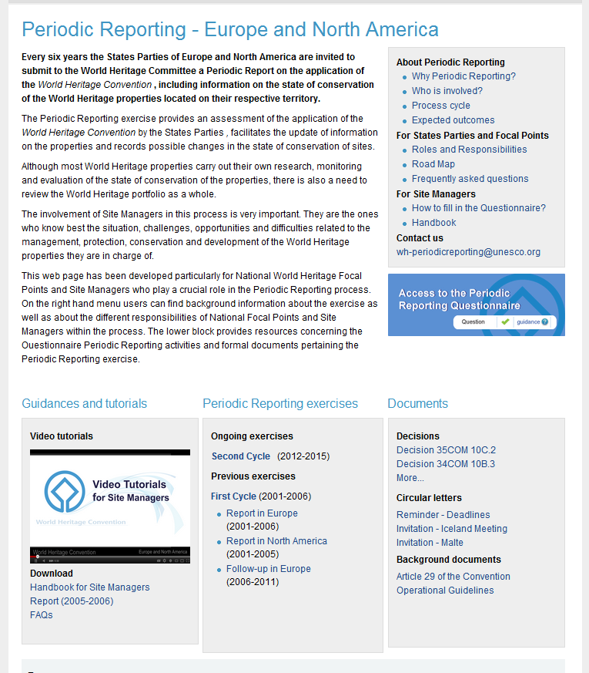
Periodic Reporting Online Tool
Online platform:
whc.unesco.org/en/153
National Focal Points:
Fill-in and validate Section I
Validate Section II
Submit Sections I and II
Site Manager:
Fill-in Section II
Notes:
As you all know, the Periodic Reporting questionnaires were developed as online surveys. For the end users, the Focal Points and Site Managers, the questionnaires are divided into two sections.

Slide 3
Section I
Implementation of the World Heritage Convention at national level
Concerns all cultural and natural heritage (World Heritage or not)
Filled-in, validated and submitted by the Focal Point – i.e. the responsibility of the national heritage institutions
13 chapters, 93 questions (+categories/alternatives)

Slide 4
Structure of Section I
Introduction
Inventories/lists/registers for cultural and natural heritage
Tentative List
Nominations
General Policy Development
Status of Services for Protection, Conservation and Presentation
Scientific and Technical Studies and Research
Financial Status and Human Resources
Training
International Cooperation
Education, Information and Awareness Building
Conclusions and Recommended Actions
Assessment of the Periodic Reporting Exercise

Slide 5
Section II
Concerns each World Heritage property
6 chapters
170 questions
Notes:
What has changed since the first cycle?
Online tool
Prefilling
Qualitative focus
Assessment of factors affecting the property
Assessment of management needs
It is shorter, quicker to answer, easier to understand.
It is a reference for the management of the property, in other words USEFUL, more linked to other processes

Slide 6
Structure of Section II
1. World Heritage Property Data
2. Statement of Outstanding Universal Value
3. Factors affecting the Property

Slide 7
Section II: The Factors
Buildings and development
Transportation infrastructures
Services infrastructures
Pollution
Biological resource use/modification
Physical resource extraction
Local conditions affecting physical fabric
Social/cultural uses of heritage
Other human activities
Climate change and severe weather events
Sudden ecological or geological events
Invasive/alien species or hyper-abundant species
Management and institutional factors
Other factor(s)

Slide 8
Structure of Section II
1. World Heritage Property Data
2. Statement of Outstanding Universal Value
3. Factors affecting the Property
4. Protection, Management and Monitoring of the Property
5. Summary and Conclusions
6. Conclusions of the Periodic Reporting Exercise

Slide 9
Pre-filling done by WHC
The methodology of pre-filling is based upon the following principles:
Only information submitted officially by the State Party is used
Only data referring to the World Heritage property as inscribed are included‏
The pre-filling is made on the basis of what is available at the World Heritage Centre, not necessarily of what exists at the national level
The pre-filling is made in the language of the Nomination file
All documents mentioned in the questionnaire (map, Management plan, etc.) can be downloaded

Slide 10
Pre-filling: which paragraphs?
Property data
Statements of Outstanding Universal Value
Protection and Management
International assistance

Slide 11
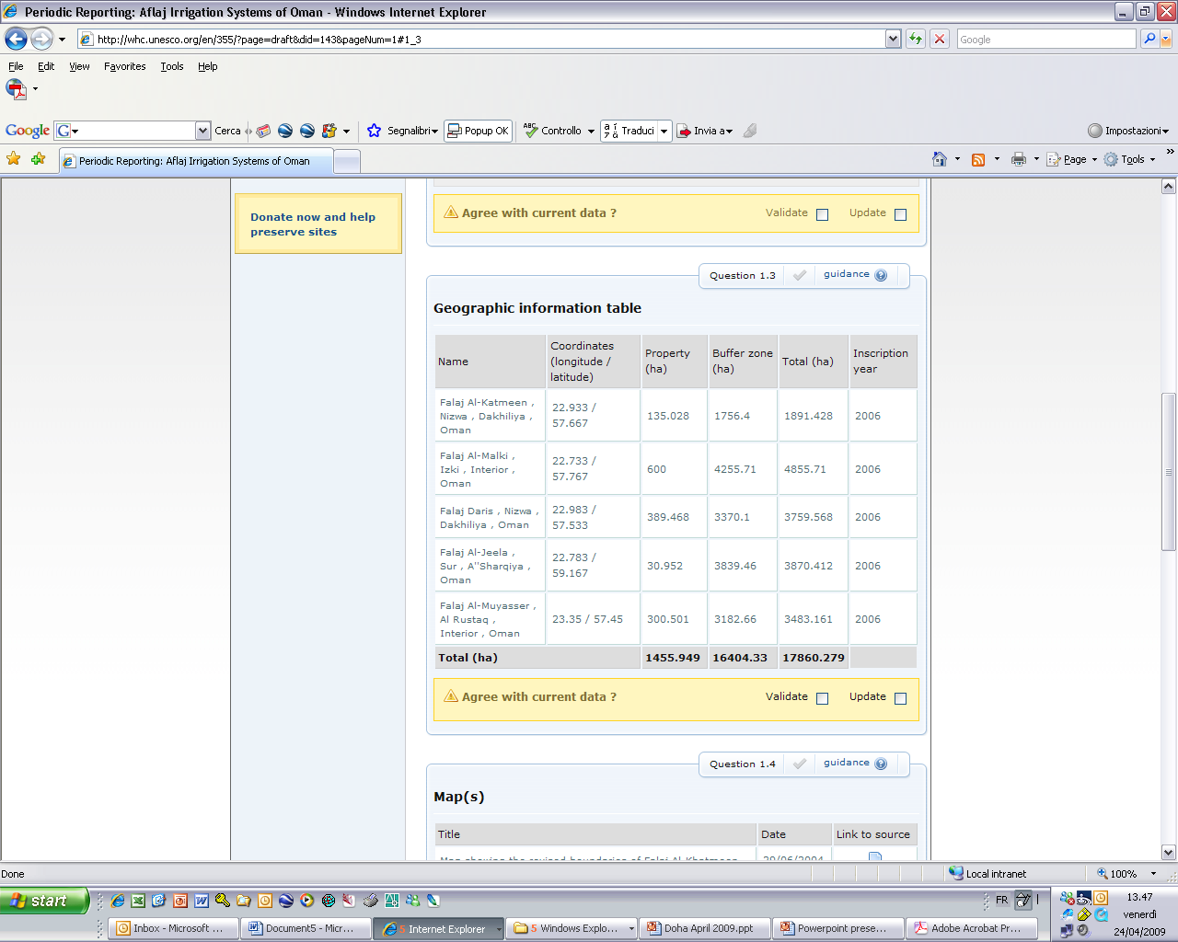
The types of questions:
1) Validate and Update

Slide 12
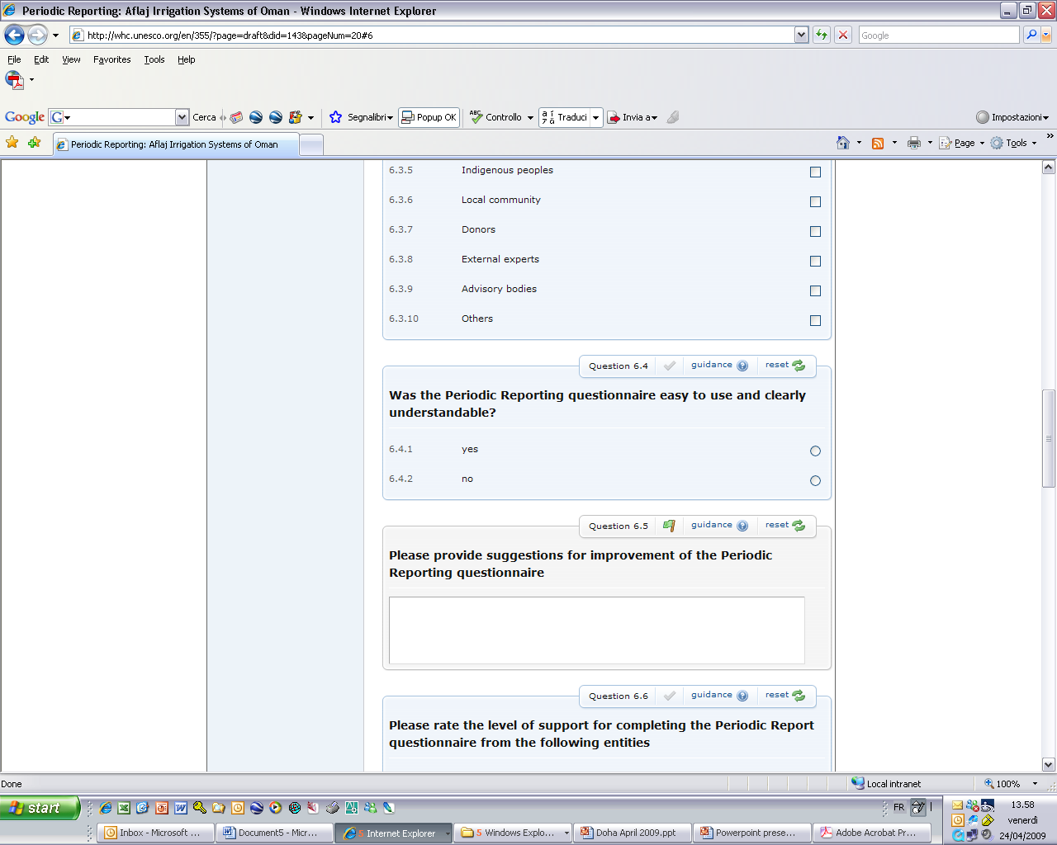
The types of questions:
2) Yes / No

Slide 13
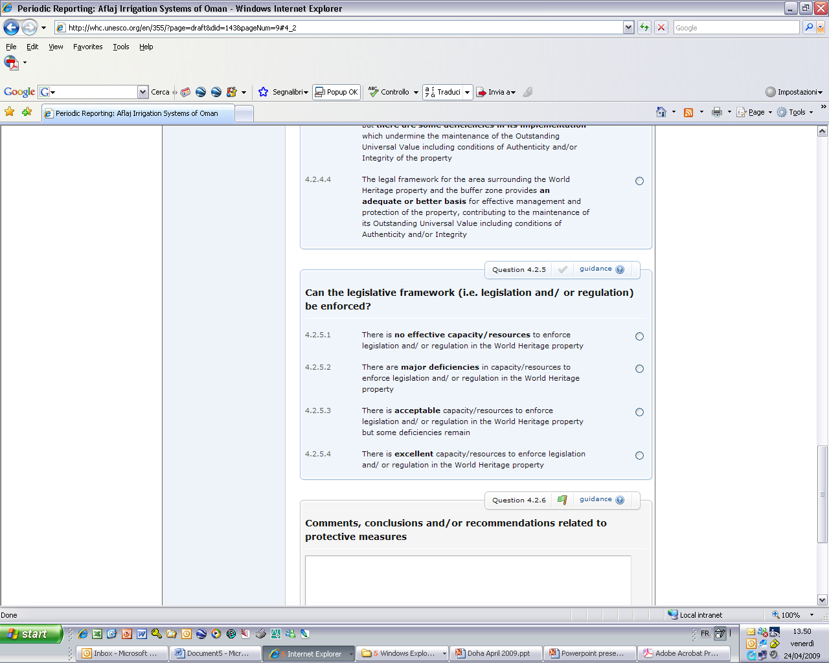
The types of questions:
3) Multiple choice (one answer)

Slide 14
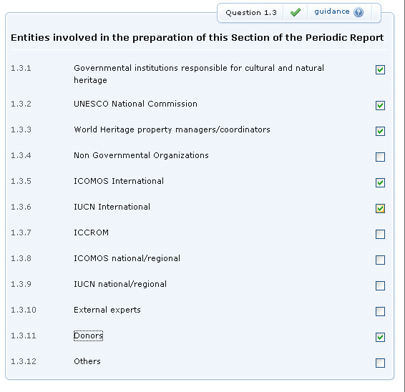
The types of questions:
3) Multiple choice (more answers)

Slide 15
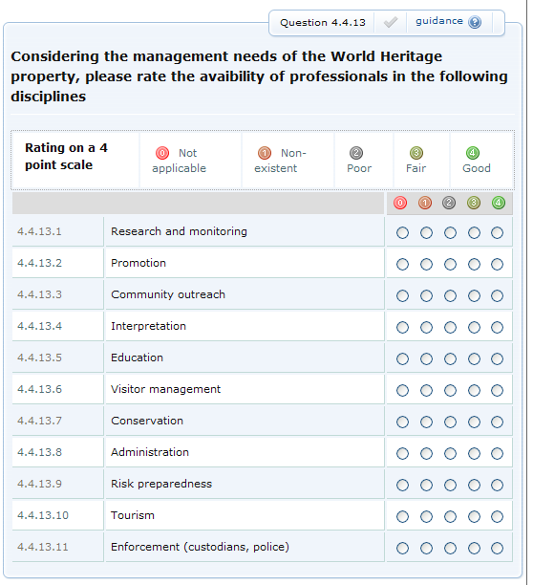
The types of questions:
4) Rating

Slide 16
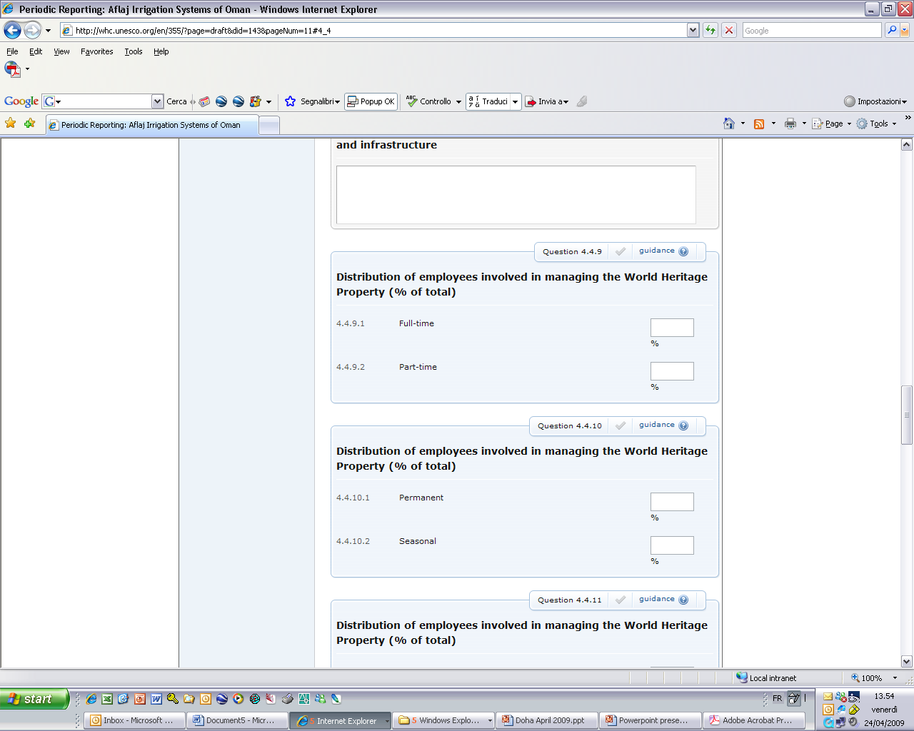
The types of questions:
5) Percentages
N.B. Both cells have to be filled-in. Make sure that, if you write ‘100’ in one of them, you write ‘0’ in the other

Slide 17
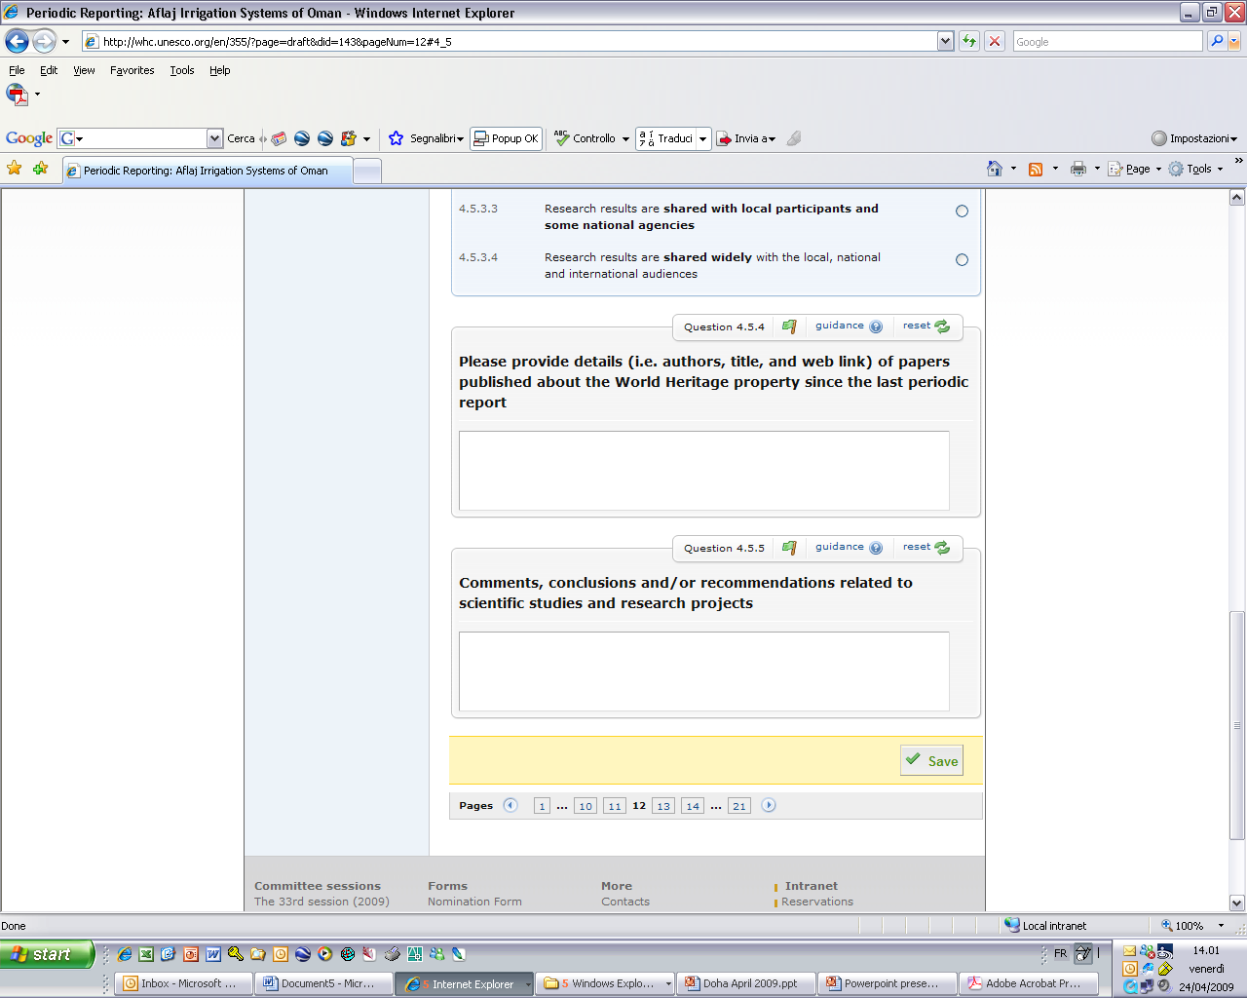
The types of questions:
6) Open field
Maximum 500 characters allowed!

Slide 18
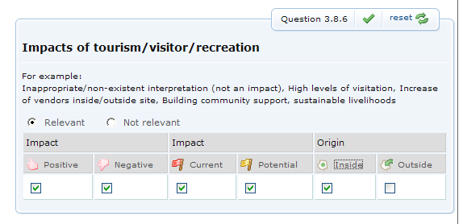
The types of questions:
7) Assessment

Slide 19
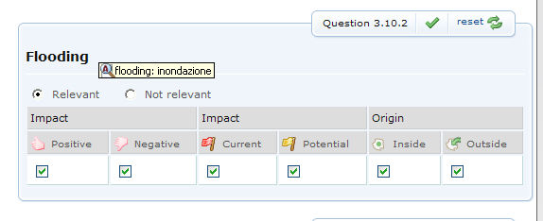
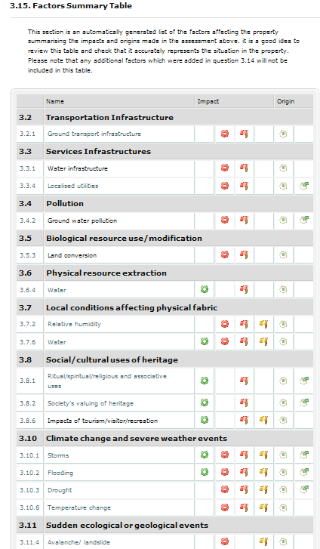
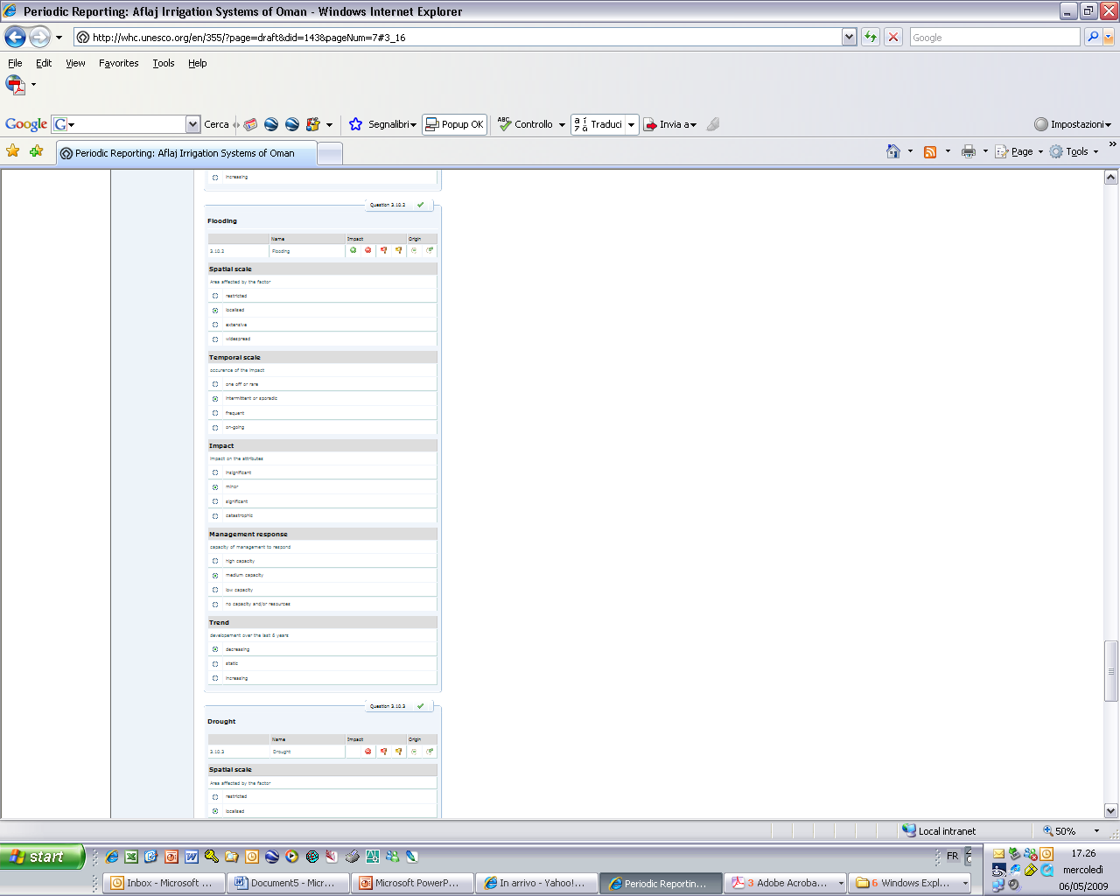
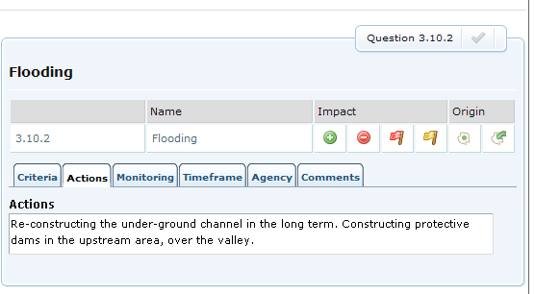
Summary Table example: Factors’ Cycle, Section II
3) Assessment of the current negative factors
1) Identification
2) Summary Table
4) Management responses

Slide 20
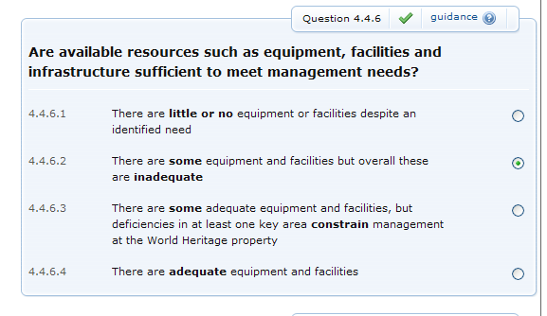
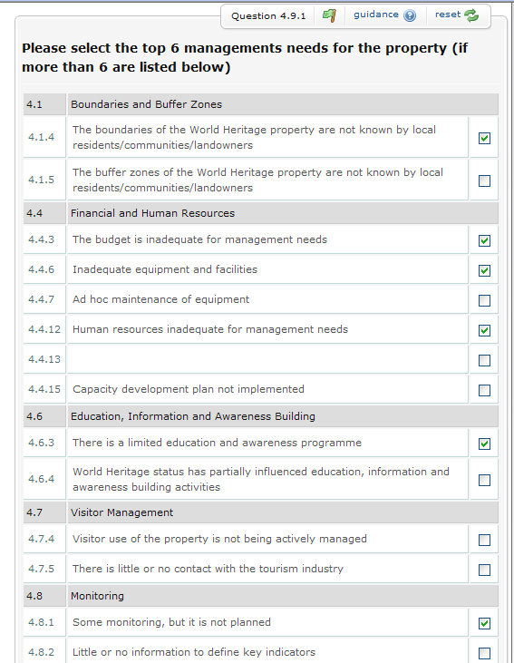
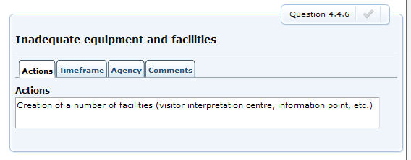
The Management Needs’ Cycle
1) identification
2) choice (6 key management needs)
3) identification of management responses

Slide 21
Periodic Reporting: Data collection
...and quantitative data
The questionnaires provide us with both qualitative data...
Notes:
The information is collected through the online questionnaires, which provide on one side qualitative data, which in its most qualitative form are free-text inputs like the comment box shown on the screen here.
CLICK CLICK
The questionnaires also provide us with quantitative data through a range of different types of questions.
The quantitative data have both a quantitative and qualitative character, in particular this relates to the data concerning the factors impacting on the properties and management needs.

Slide 22
Periodic Reporting: Data analysis –
These data allow us to perform analyses at both global, regional, sub-regional, country and WH property levels
The quantitative and qualitative data require different analytical approaches
EUR PR:
  47 States Parties, 424 WH properties
  66 358 rows of data
  660 columns of indicators
  1 913 256 cells of data
Notes:
The data allows us to do analyses at several levels.
CLICK
The quantitative and qualitative data obviously require different analytical approaches. The qualitative data require a very labour intensive analytical approach because it demands that somebody actually reads it and analyses them « manually ». For instance, the input in comment fields has very high national value, but is very demanding on the analysis team, especially because of the volume of information due to the sheer number of sites in Europe…
I consider myself lucky, as I have worked mostly with the quantitative data – which can be structured and fit into systems.
CLICK
Still, for Europe, with 47 States Parties and 424 WH properties, we ended up with 66 358 rows of data, 660 columns of indicators, and a total of 1 913 256 cells of data in six datasets…so as you understand, a systematic and quantitative approach has been very much necessary.

Slide 23
Periodic Reporting: Data analysis –
Validity and methods
Method for data collection:
Self evaluation through online tool
For analytical purposes, the reliability and validity of the data and conlusions drawn from them must be considered
  The information provided through the questionnaires was cross-checked and triangulated with other sources in the analysis process, such as:
  Advisory Bodies’ interventions
  Other available Information at WHC (SOC reports, reactive monitoring reports, regional and sub-regional meeting reports)
  Cf. Decision 29 COM 7B, where the COM calls for
  “cross-referencing between state of conservation and periodic reports to
  enhance consistency in reporting mechanisms and to ensure that
  follow-up action is taken as necessary;”
Notes:
But a systematic approach in itself is not enough, we need to look at the data material and data collection methods before we can draw any conclusions:
*The methodology for data collection in Periodic Reporting is self-evaluation through an online tool.
*The national Focal Points fill in, validate and submit Section I, while the site managers fill in Section II. The Focal Points then have to validate and submit Section II for the World Heritage properties in their respective countries.
The intention of this is to safeguard that true and reliable information regarding national implementation programmes and World Heritage properties’ conservation schemes is provided.
CLICK
For analytical purposes, the reliability and validity of the data and conclusions drawn from them must be considered.
Reliability is a prerequisite for findings and conclusions to have validity. The reliability can be referred to as level of precision (i.e. will we get the same results if the exercise is repeated under similar circumstances). Validity on the other hand can be referred to as degree of accuracy (i.e. “do we measure what we want to measure”). The validity in this case partly refers to whether the Periodic Report can be considered a truthful depiction of what was analysed, i.e. the implementation of the Convention in the States Parties, and the state of conservation of the World Heritage properties. Further, validity refers to the rigour with which the study was conducted (its design, decisions concerning what was and was not measured, the care taken in conducting these measurements etc.).
It should be noted that questionnaires based on self-reporting are often claimed to lack validity for a number of reasons. Self-reporting always implies a degree of subjectivity, and the validation process of Section II might also be reflected in the results. Further, the way questions are first formulated by the team requesting information and secondly understood by the end user, might have impacts on the results.
The Periodic Reporting Questionnaire is designed to be as accurate or precise as possible for its purpose, but discussions regarding the Questionnaire have taken place across the regions during the Periodic Reporting exercise, and National Focal Points have raised issues regarding reliability and validity. States Parties have considered a number of questions imprecise, difficult to comprehend and/or respond to. In particular, it has been emphasised that Section II is not precise or specific enough for neither cultural nor natural properties. Further, certain trans-boundary and serial properties considered that specific issues related to such properties were not sufficiently covered in Section II. Finally, discussions have been taking place concerning whether the collected data are indeed reflecting the current situation in the region.
Level of precision in the tool itself is one thing, but we also have sites in our datasets reporting that earthquakes and volcanic eruptions are potential positive factors for the state of conservation, we have natural sites claiming that their authenticity is preserved, although authenticity is N/A for natural sites – and there is a category of answer for the natural sites saying just that. So we need to carefully ask ourselves – how much can we trust these data? And how far can we go with them? We have for example avoided correlations and the temptation of trying to find causal connections – we simply can’t trust these data alone for those purposes.
CLICK
In order to balance some of these issues regarding the validity of the Periodic Report, conscious efforts are made to utilise knowledge obtained through other sources in the analysis process.
CLICK
The Advisory Bodies’ interventions and the available information at the World Heritage Centre, CLICK such as the regional and sub-regional meeting reports, state of conservation reports and reactive monitoring reports have been used for cross-referencing and data-triangulation.
CLICK
This is in line with the World Heritage Committee’s call “for cross-referencing between state of conservation and periodic reports to enhance consistency in reporting mechanisms and to ensure that follow-up action is taken as necessary;” (Decision 29 COM 7B).
These cross-references, as well as the implementation strategy for the Periodic Reporting exercise in Europe, with frequent State Party consultation meetings, are crucial for the overall reliability and validity of our conclusions to be considered satisfactory.

Slide 24
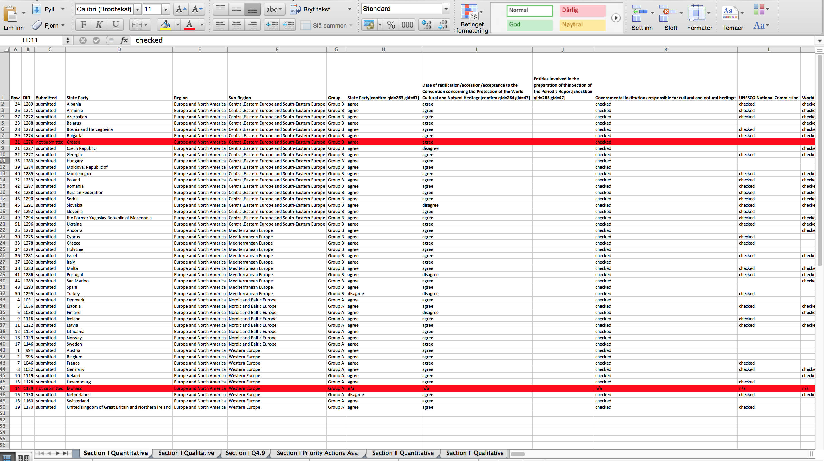
Periodic Reporting: Data analysis –
Quantitative data
Notes:
Let us have a quick look at the work with the quantitative data
We extracted all the quantitative data from the questionnaires and created datasets which can be imported into Excel or any statistical programme like SPSS, one for Section I, one for Section II and separate datasets for the Factors affecting the properties under Section II, as well as the various summary sections, in total 6 datasets

Slide 25
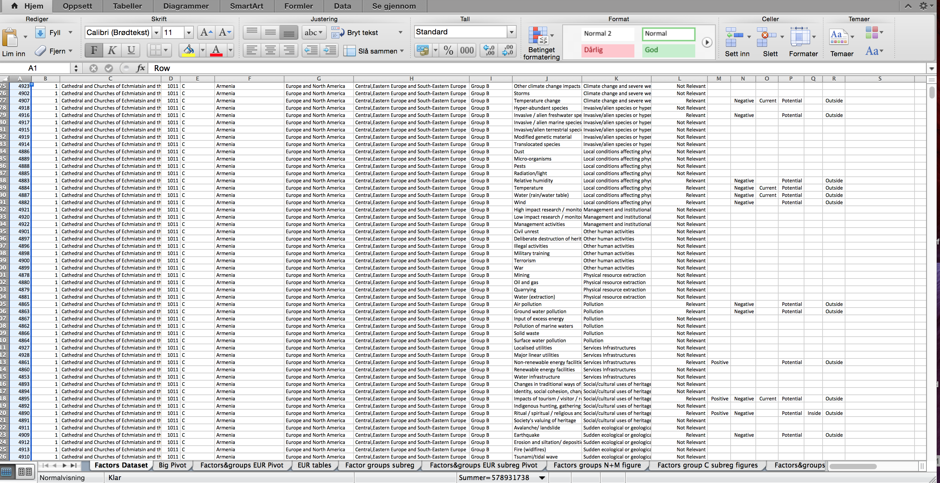
Periodic Reporting: Data analysis –
Quantitative data
Notes:
This is an excerpt of the dataset for factors affecting the properties, containing a total of 32802 rows of data. This is maybe the most complex part of PR as we can’t count the values, there is simply too much data

Slide 26
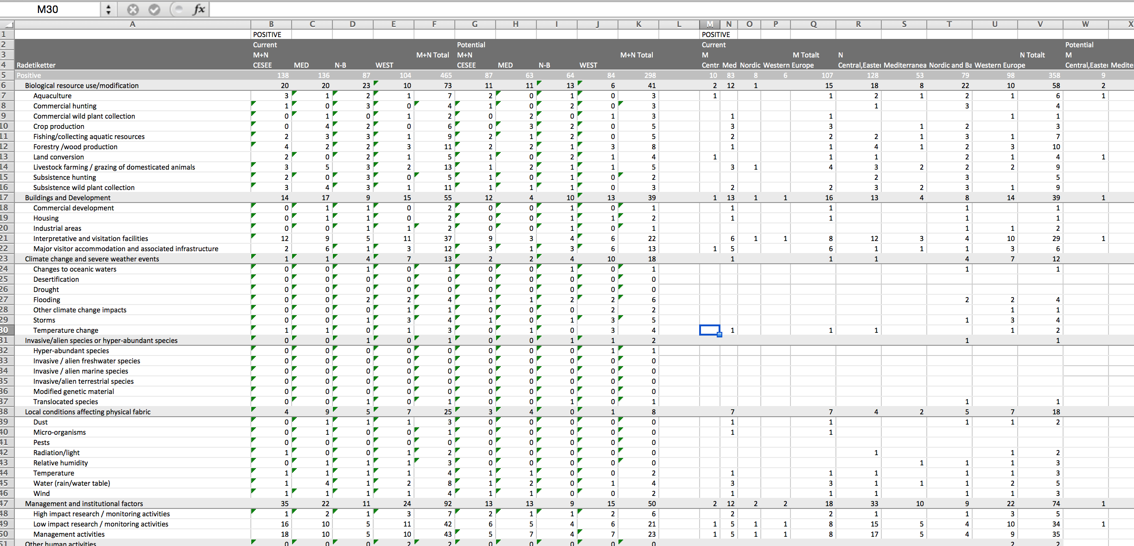
Periodic Reporting: Data analysis –
Quantitative data
Notes:
The factors need considerable massaging before we are able to read anything sensible out of them. We also experienced various issues as we went along. We decided to use excel this time, so that everybody could access the analysis – one unforeseen problem was that excel refused to count indicators reported to have more than one value – for example when it comes to factors, excel doesn’t count factors reported to have negative AND positive impacts – meaning all positive and all negative impacts have to be counted separately and not in the same tables.

Slide 27
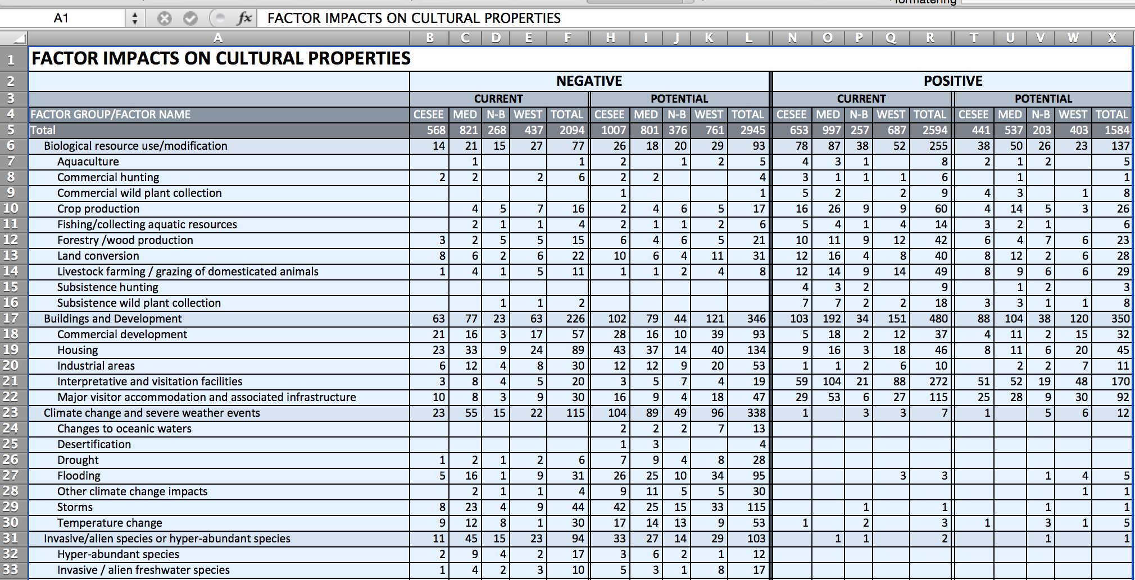
Periodic Reporting: Data analysis –
Quantitative data
Notes:
But - after a bit of massaging of the data, we end up here, being able to present all the values in a hopefully quite readable tabular format.

Slide 28
Periodic Reporting: Data analysis –
Quantitative data
Through statistical analysis, we created graphs showing the rather complex mass of data in a more comprehensible way:
Notes:
Based on what you saw in the previous three slides, we can again develop graphic depictions, like this graph which shows the data from the 32802 rows of data in compressed form, portraying the levels of positive and negative impacts by factors on cultural properties in Europe (All properties, weighted factor groups, ranked) THIS TABLE CAN BE FOUND ON P XX IN DOCUMENT 10A
We have chosen to include also the positive current and potential impacts – look for example at tourism here – yes it’s reported to be the most negative factor on our sites, but also a hugely positive factor with a significant amount of potential positive effects. We have chosen to break down the data into sub-regions and site typologies, according to the wishes of the states parties
We hope that the Periodic Report and the quantitative summaries are useful in providing a baseline and starting points for further discussions, and I sincerely hope that we have managed to highlight some of the challenges and issues we see with these data from Periodic Reporting, but I must also emphasise that we are sitting on a treasure-throve of valuable information here. My colleagues Christopher Young, Pierre Galland and Katri Lisitsin will take you through the substance.

Slide 29
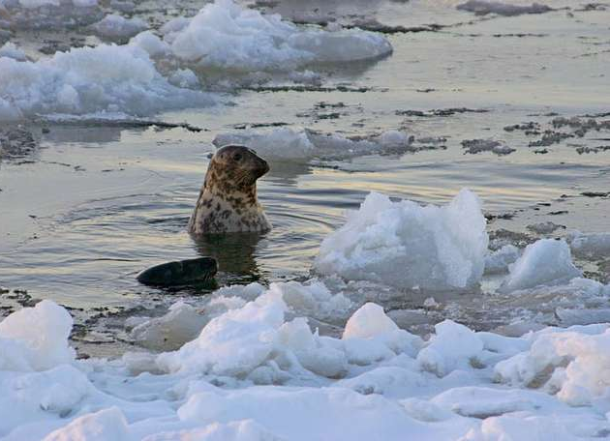
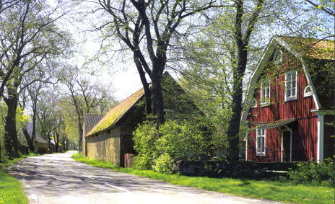
High Coast / Kvarken Archipelago
Agricultural Landscape of Southern Öland
THANK YOU! MERCI!

