Slide 1

Side Event:
Capacity-Building Strategy Initiative for Central, Eastern and South-Eastern Europe Region
37th session of the World Heritage Committee
Phnom Penh, 19 June 2013, 13.15 – 14.30

Slide 2
Agenda
A note on capacity-building
Initiative of EUR/NA for CESEE as follow-up of First PR cycle
Work approach and work in progress
Presentation of Blueprint
Profile of coordinating lead organisation/s
The way forward – discussion

Slide 3
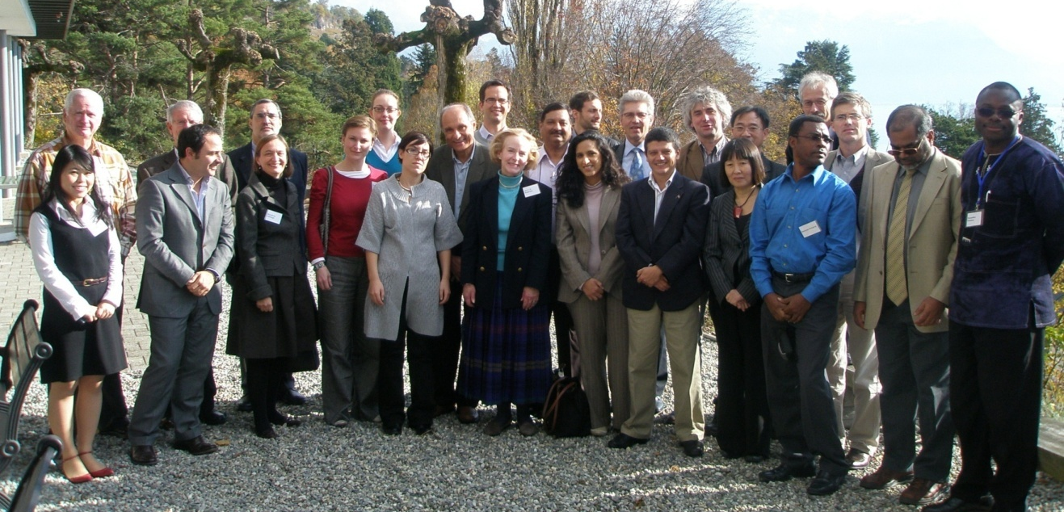

A note on capacity-building
The World Heritage Capacity Building Strategy
  Developed with IUCN, ICOMOS, the World Heritage Centre and a number of other partners and individual specialists
  Adopted by The Committee at its 35th Session in 2011

Slide 4
A note on capacity-building
Two key paradigm shifts
Brining culture and nature sectors together
Moving from Training to Capacity Building

Slide 5
Training focused on providing knowledge, skills and awareness to heritage practitioners.
Capacity Building focuses on much broader set of audiences
Capacity is ability to perform functions, solve problems, set and achieve objectives by individuals, institutions and society.
Therefore, capacities reside not only on practitioners but also on institutions and communities & networks therefore there are other responsible audiences

Slide 6
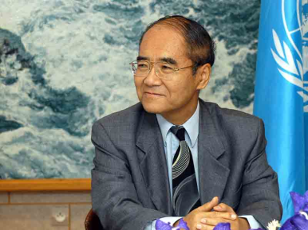
CAPACITIES
Communities & Networks
Without the understanding and support
of the public at large, without the respect
and daily care of the local communities,
which are the true custodians of World
Heritage, no amount of funds or army
of experts will suffice in protecting the sites’
  Mr Koichiro Matsuura-
  Former DG UNESCO
Institutions
Practitioners
The world
The world
HERITAGE
(Audiences)
Policy makers
Decision makers
Committee members
Advisory Bodies
(Audiences)
Those working directly
Professionals:
International
and national

Slide 7
Identifying where capacities reside and target audiences…
Where capacities reside and associated audiences: | Some principal learning areas:
Practitioners Those with direct responsibilities for heritage | Implementation of the Convention Conservation and management issues Technical and scientific issues Resource utilization and management
Institutions Decision-and policy-makers | Legislative issues Institutional frameworks/issues Financial issues Human resources Knowledge
Communities & networks All those who have a legitimate interest in heritage | Reciprocal benefits and linking with sustainable development Stewardship Communication / Interpretation
…and corresponding learning areas

Slide 8
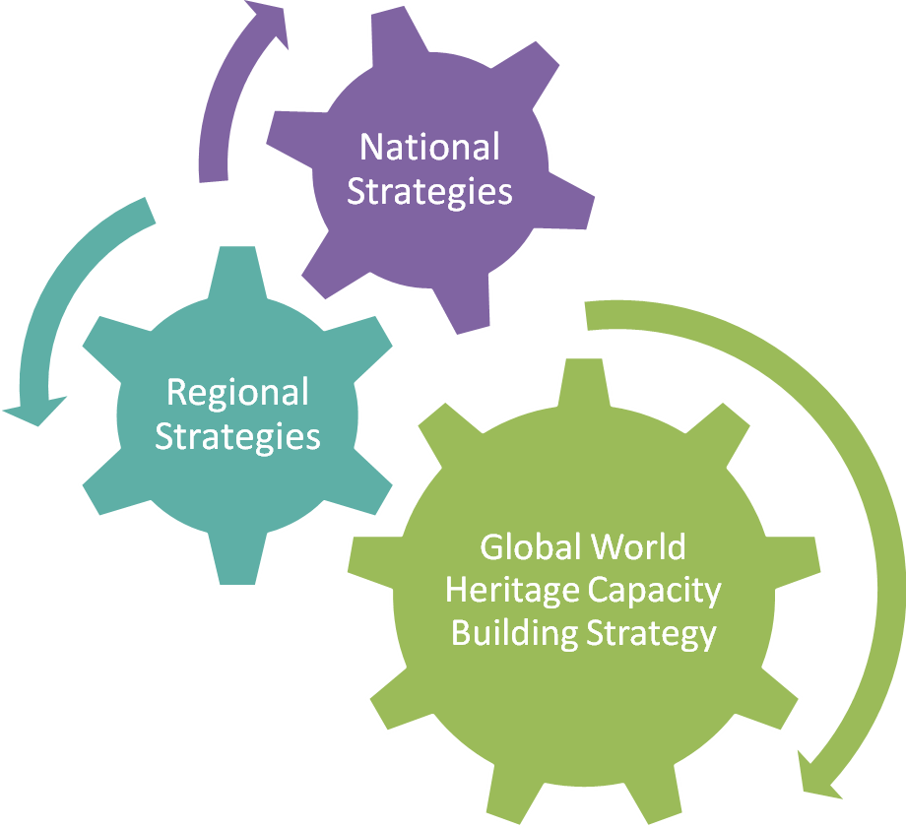
Strategies at 3 different levels expected

Slide 9
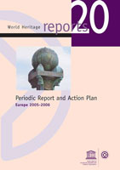
Initiative of EUR/NA for CESEE as follow-up of First PR cycle

Slide 10
The Periodic Reporting Exercise in support of the implementation of the 5Cs Strategic Objectives
Main obstacles/difficulties
Main needs
Statistics based on the contributions made by CESEE States Parties in the framework of the Sub-Regional Workshop For the World Heritage National Focal Points in the CESEE Europe (14-16 November), Tbilissi, Georgia

Slide 11
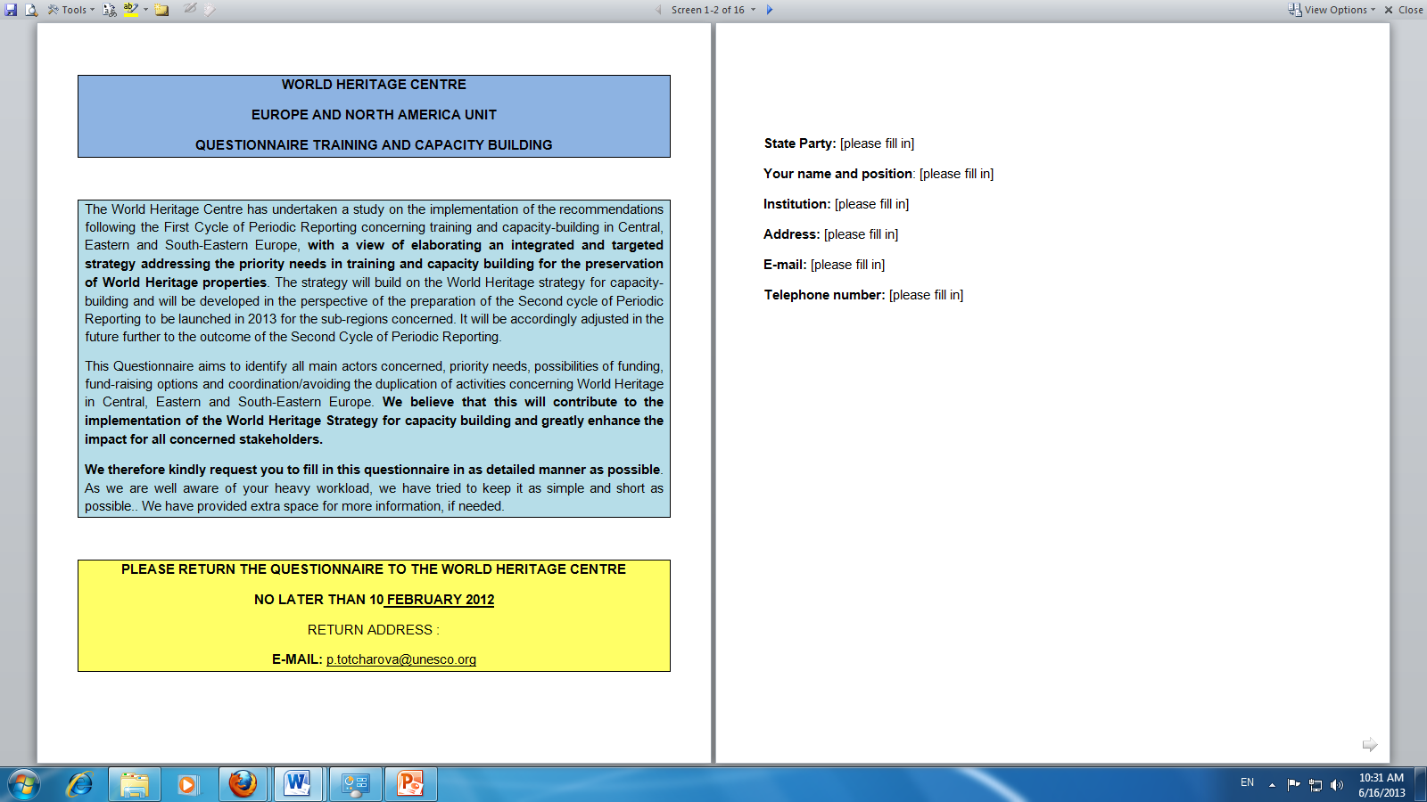

Work approach – tailored to sub-region and State Party-driven
End of 2011: Elaboration of Training and Capacity-Building questionnaire
January 2012: Training and Capacity-Building questionnaire sent out to the States Parties in the sub-regions
November 2012: Creation of Steering Group with representatives from States Parties of the sub-regions, ICCROM, IUCN and the World Heritage Centre
March 2013: Telephone conference on the preparation of the Blueprint Document and feedback from the Steering Group
May 2013: Blueprint produced in May 2013 as basis for discussion for the future Strategy

Slide 12
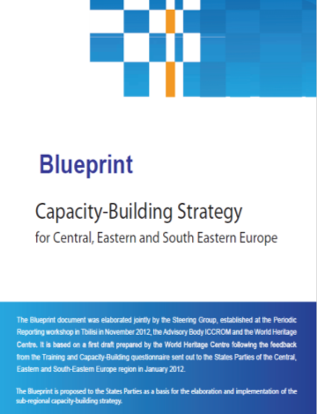
The Blueprint of the Capacity-Building Strategy
Content:
Aim of the blueprint
Vision
Background
Brief overview on the current Training and Capacity building in Central, Eastern and South Eastern Europe
Availability of Training and Capacity Building
Training needs
Needs in relation to training materials and toolkits
Targeted Audience in relation to Training and Capacity Building
Underlying Considerations
Regional best-practices to be explored
Funding matters
A note on information resources
Specific approaches regarding training and capacity building
What can be done? Ideas concerning coordination and implementation of the strategy
Contact point at the World Heritage Centre

Slide 13
Profile of coordinating (lead) organisation/s
They could be invited to attend the meetings for the Periodic Reporting and other relevant meetings
Determine/s if the results of the Periodic Reporting questionnaires will yield further capacity-building needs
Pilot/s the preparation/implementation of the capacity-building strategy and associated programme(s) as appropriate
Elaborate/s a concrete programme accompanying the strategy identifying specific activities, timelines, responsibilities, and necessary resources.
Source: WHC-11/35.COM/9B

Slide 14
Category-2-Centres
UNESCO Category II Centres (C2Cs):
These organizations operate under the auspices of UNESCO and are committed to engage in support of UNESCO’s strategic programme objectives (in this case support for the implementation of the World Heritage Convention). They are funded directly by Member States where they are located. The C2Cs are difficult to characterize in general because they take on different structures. Some are regional in scope while others cover more than one region or are organized around a thematic issue.
Many are involved in capacity building and research, while several are set up as foundations or funds to support those activities carried out by other organizations.
Source: WHC-11/35.COM/9B

Slide 15
For the latest info please visit:
http://whc.unesco.org/en/eur-na
http://whc.unesco.org/en/events/1054/

