Slide 1

RESULTS OF SECTION II
Final meeting of the Second Cycle of the Periodic Reporting exercise for the Latin America and Caribbean Region. 2 – 5 December. Santiago de Chile

Slide 2
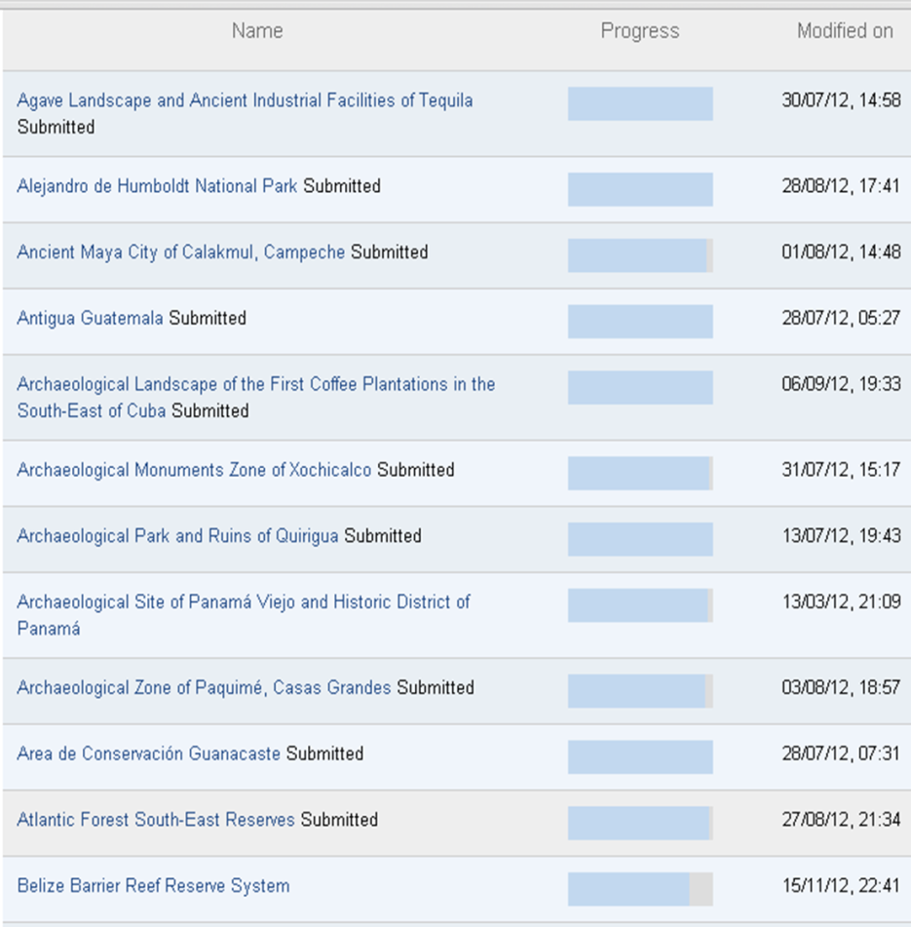
Countries and World Heritage sites that submitted the questionnaire for the Second Cycle of the Periodic Reporting Exercise for LAC Region by 23rd November 2012, 12:00 GMT +1
COMPLETION OF PERIODIC REPORTING
Section I: 28 out of 32 countries submitted
Section II: 114 out of 127 Sites submitted
Antigua and Barbuda | Guyana
Argentina | Haiti
Barbados | Jamaica
Bolivia (Plurinational State of) | Mexico
Brazil | Nicaragua
Colombia | Paraguay
Costa Rica | Peru
Cuba | Saint Kitts and Nevis
Dominica | Saint Lucia
Dominican Republic | Saint Vincent and the Grenadines
Ecuador | Suriname
El Salvador | Trinidad and Tobago
Grenada | Uruguay
Guatemala | Venezuela (Bolivarian Republic of)

Slide 3
TENTATIVE LIST
How many Tentative Lists were inscribed in the respective years according to the sub-regions of the Latin America and the Caribbean region?

Slide 4
LEGAL FRAMEWORK
4.2.2 – Adequacy of legal framework
4.2.2 – Is the legal framework (i.e. legislation and/or regulation) adequate for maintaining the OUV including conditions of Integrity and/or Authenticity of the property?
NUMBER and percentage of World Heritage Sites (WHS)

Slide 5
4.2.3 – Is the legal framework (i.e. legislation and/or regulation) adequate in the buffer zone for maintaining the OUV including conditions of Integrity and/or Authenticity of the property?
LEGAL FRAMEWORK
4.2.3 – Adequacy of legal framework in the buffer zone
NUMBER and percentage of World Heritage Sites (WHS)

Slide 6
4.2.4 – Is the legal framework (i.e. legislation and/or regulation) adequate in the area surrounding the World Heritage property and buffer zone for maintaining the OUV including conditions of Integrity and/or Authenticity of the property?
LEGAL FRAMEWORK
4.2.4 – Adequacy of legal framework in the surrounding area
NUMBER and percentage of World Heritage Sites (WHS)

Slide 7
4.3.3 - How well do the various levels of administration (i.e. national/federal; regional/provincial/state; local/municipal etc.) coordinate in the management of the World Heritage Property? (number of countries)
MANAGEMENT
4.3.3 – Level of coordination in the management
NUMBER and percentage of World Heritage Sites (WHS)

Slide 8
MANAGEMENT
4.3.4 – Is the management system / plan adequate to maintain the property`s OUV?
4.3.5 – Is the management system being implemented?
4.3.4.
4.3.5.
NUMBER and percentage of World Heritage Sites (WHS)

Slide 9
MANAGEMENT
4.3.6 - Is there an annual work/action plan and is it being implemented?
NUMBER and percentage of World Heritage Sites (WHS)

Slide 10
MANAGEMENT
4.3.8 – Input in management decisions
4.3.8 - If present, do local communities resident in or near the World Heritage property and/or buffer zone have input in management decisions that maintain the Outstanding Universal Value?
NUMBER and percentage of World Heritage Sites (WHS)

Slide 11
MANAGEMENT
4.3.9 – Input in management decisions
4.3.9 - If present, do indigenous peoples resident in or regularly using the World Heritage property and/or buffer zone have input in management decisions that maintain the Outstanding Universal Value?
NUMBER and percentage of World Heritage Sites (WHS)

Slide 12
Thank you for your attention!

