Slide 1

RESULTS OF SECTION I
Final meeting of the Second Cycle of the Periodic Reporting exercise for the Latin America and Caribbean Region. 2 – 5 December. Santiago de Chile.

Slide 2
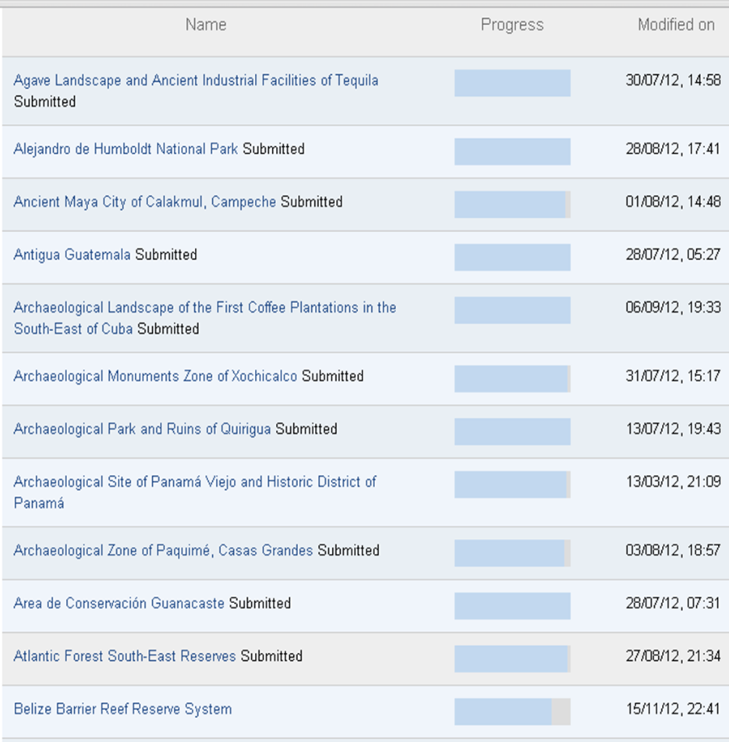
Countries and World Heritage sites that submitted the questionnaire for the Second Cycle of the Periodic Reporting Exercise for LAC Region by 23rd November 2012, 12:00 GMT +1
COMPLETION OF PERIODIC REPORTING
Section I: 28 out of 32 countries submitted
Section II: 114 out of 127 Sites submitted
Antigua and Barbuda | Guyana
Argentina | Haiti
Barbados | Jamaica
Bolivia (Plurinational State of) | Mexico
Brazil | Nicaragua
Colombia | Paraguay
Costa Rica | Peru
Cuba | Saint Kitts and Nevis
Dominica | Saint Lucia
Dominican Republic | Saint Vincent and the Grenadines
Ecuador | Suriname
El Salvador | Trinidad and Tobago
Grenada | Uruguay
Guatemala | Venezuela (Bolivarian Republic of)

Slide 3
2.1 – If the State Party has established inventories/lists/registers of cultural heritage, at what level(s) are they compiled and what is their current status?
INVENTORIES
*No detailed responses, comments on answer “2.2.4. – Other”

Slide 4
2.2 – If the State Party has established inventories/lists/registers of natural heritage, at what level(s) are they compiled and what is their current status?
INVENTORIES
*No detailed responses, comments on answer “2.2.4. – Other”

Slide 5
2.3 – Are inventories/lists/registers adequate to capture the diversity of cultural and natural heritage in the State Party?
INVENTORIES
NUMBER and percentage of States Parties (SP)

Slide 6
2.4 - Are inventories/lists/registers used to protect the identified cultural heritage?
2.5 - Are inventories/lists/registers used to protect the identified natural heritage?
INVENTORIES
NUMBER and percentage of States Parties (SP)

Slide 7
2.6 - Are inventories/lists/registers used for the identification of properties for the Tentative List?
INVENTORIES
NUMBER and percentage of States Parties (SP)

Slide 8
3.3 – Level of involvement in the preparation of the Tentative List
TENTATIVE LIST

Slide 9
4.2 – Please rate level of involvement of the following (if applicable) in the preparation of the most recent nomination dossiers
NOMINATIONS

Slide 10
4.3 - Please rate the perceived benefits in your country of inscribing properties on the World Heritage List
NOMINATIONS
4.3.1 - Strengthened protection of sites
4.3.2 - Enhanced conservation practices
4.3.3 - Catalyst for wider community appreciation of heritage
4.2.4 - Improved presentation of sites
4.3.5 - Enhanced honour/prestige
4.3.6 - Increased funding
4.3.7 - Additional tool for lobbying/political influence
4.3.8 - Stimulus for enhanced partnerships
4.3.9 - Increased recognition for tourism and public use
4.3.10 - Stimulus for economic development in surrounding communities
4.3.11 - Others (no detailed responses, comments)

Slide 11
5.4 – Adequacy of legal framework
5.5 – Can the legal framework be enforced?
LEGAL FRAMEWORK
5.5.
5.4 - Is the legal framework (i.e. legislation and/or regulations) adequate for the identification, conservation and protection of the State Party's cultural and natural heritage?
5.4.
5.5 - Can the legal framework (i.e. legislation and/or regulations) for the identification, conservation and protection of the State Party’s cultural and natural heritage be enforced?
NUMBER and percentage of States Parties (SP)

Slide 12
10.1 – Modalities of co-operation
INTERNATIONAL COOPERATION
10.1 – If your country co-operated with other States Parties for the identification, protection, conservation and preservation of the World Heritage located on their territories since the last periodic report, please indicate the type of co-operation that best describes your activities
10.1.1 - No cooperation
10.1.2 - Participation in other UN programmes
10.1.3 - Bi-lateral and multi-lateral agreements
10.1.4 - Financial support
10.1.5 - Contributions to private organisations for the preservation of cultural and natural heritage
10.1.6 - Participation in foundations for international cooperation
10.1.7 - Sharing expertise for capacity building
10.1.8 - Hosting and/or attending international training courses/seminars
10.1.9 - Distribution of material/information
10.1.10 – Other (no detailed responses, comments)

Slide 13
Thank you for your attention!

